Slide 1
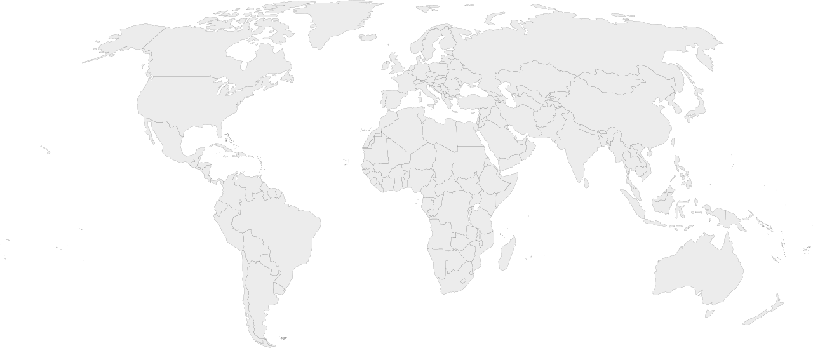
Arctic Ocean
Bering Sea

Slide 2
Gulf of Mexico
South
Pacific
Sea

Slide 3
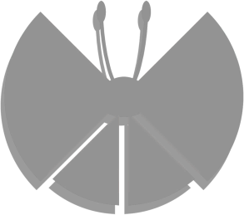
Vivillon Map
Patterns Locations

Slide 4
Greenland Sea
Baffin Bay
Northwestern Passages
Hudson Bay
Labrador Sea
North Atlantic Ocean

Slide 6
South
Atlantic
Ocean

Slide 7
Barents Sea
Kara Sea
Norwegian Sea

Slide 8
Arabian
Sea
Gulf of Aden
Laccadive Sea
Gulf of Guines

Slide 10
East Siberian Sea
Sea of Okhotsk
Sea
of Japan

Slide 11
East China Sea
Bay Of Bengal
Philippine Sea
Gulf
of Thailand
Banda Sea
Arafura Sea

Slide 12
Coral Sea
Indian
Ocean
Great Australian Bight
Tasman Sea

Slide 14
Notes:
Map Cutoffs

